Slide 1
Phone recognition system
ZHANG ZITENG TP052096
TAN WEIXIAN TP048417
LEONG SOONG JUN TP050994
LYU CHEN YANG TP052020

Slide 2

Installing
FastAI library
Two ways:
conda
pip
Usage:

Slide 3
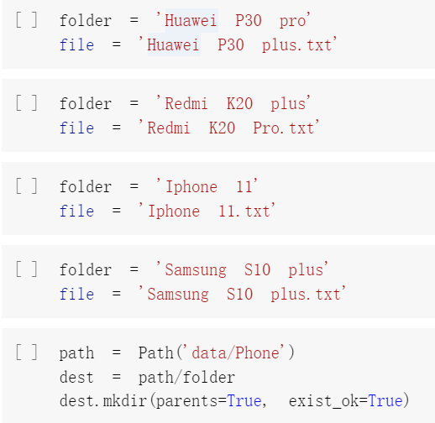
Step 1 Downloading image data

Slide 4
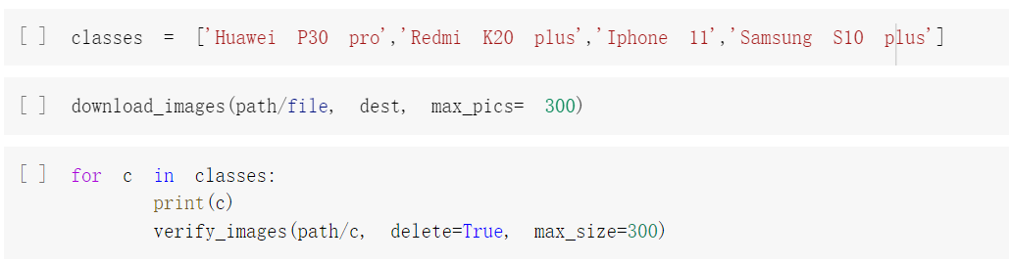
Step 1 Downloading image data

Slide 5

Suggestion
WE SHOULD ADD huge dataset TO IMPROVE THE ACCURACY RATE

Slide 6
Step 2: Loading and viewing data

Slide 7
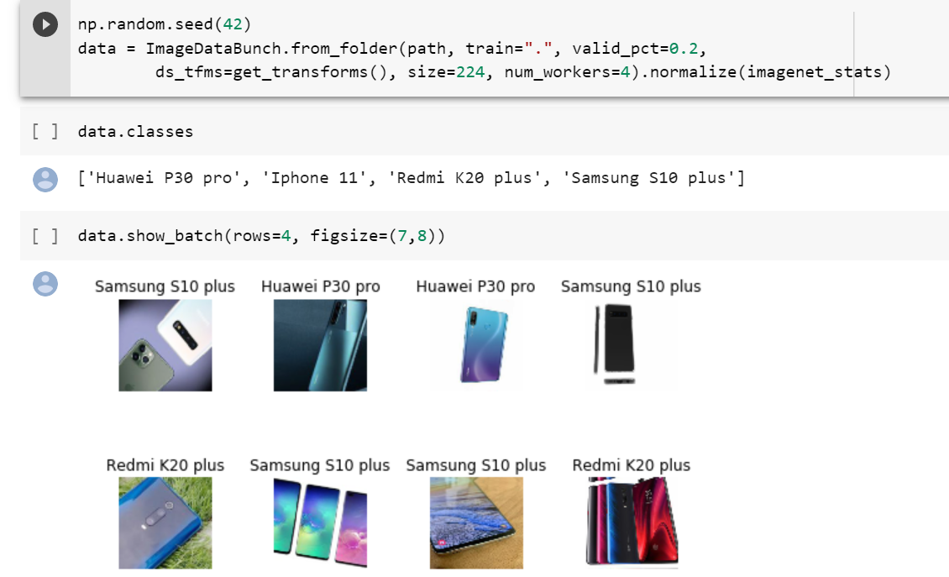

Slide 8
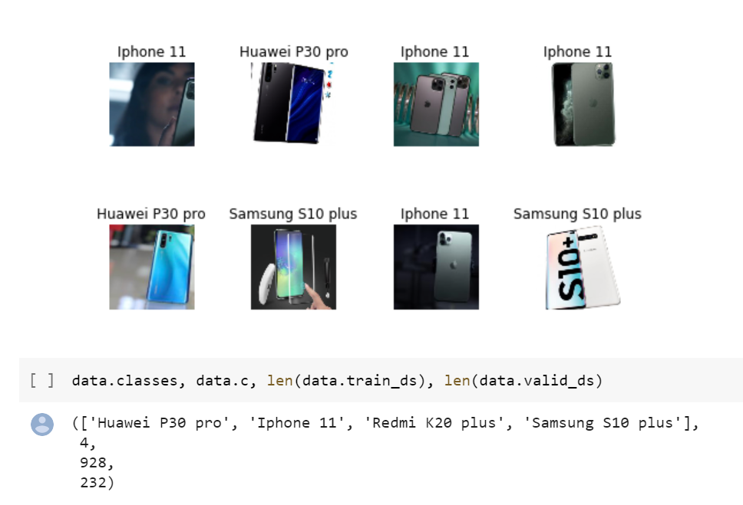

Slide 9

Suggestion
A high specification of computer devices is required

Slide 10
Step 3: Creating a model and initial training

Slide 11
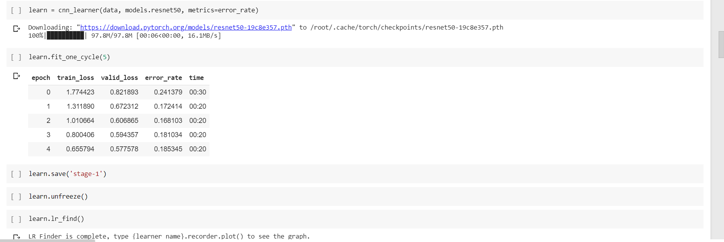
Algorithm Implementation

Slide 12
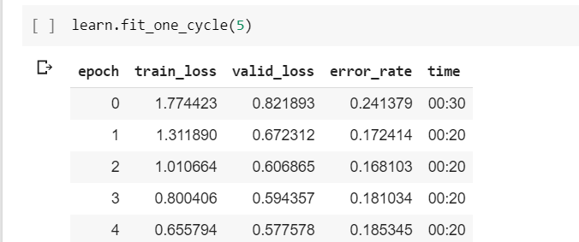

Slide 13
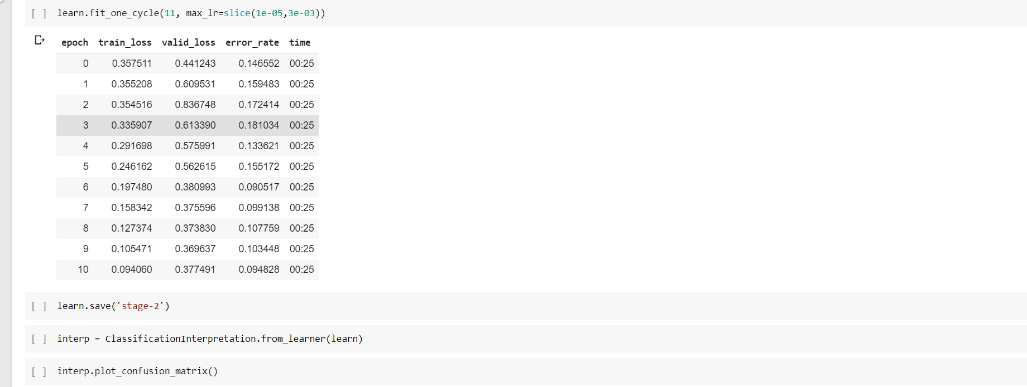

Slide 14
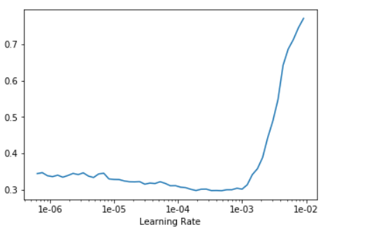
Learning Rate

Slide 15
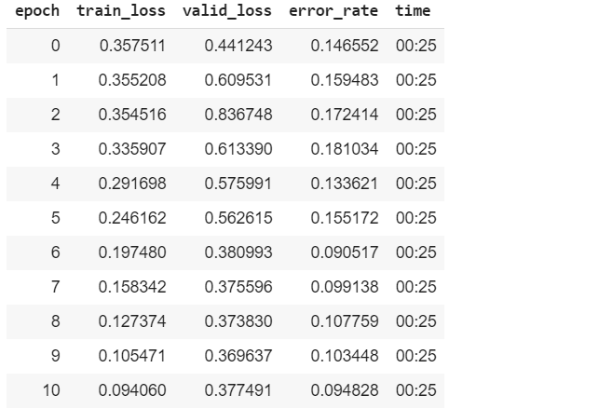
Result Of Our model

Slide 16
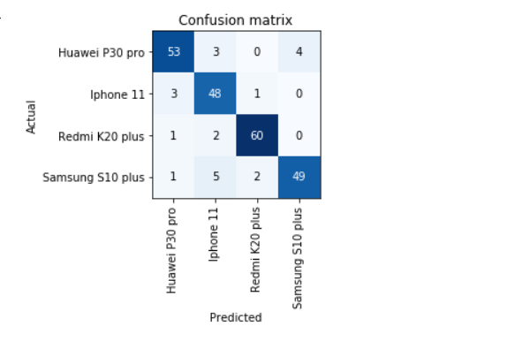
Prediction of our model

Slide 17


Slide 18

Suggestion for future work
Knowledge and experience

Slide 19
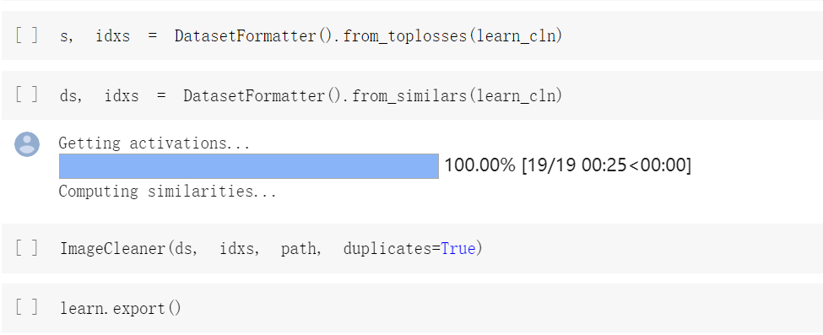

Step 4: Cleaning data and interpretation

Slide 20
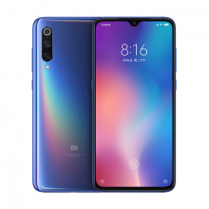
Suggestion for future work
Can identify more brands and phone models

Slide 21
Literature Review
-ZHANG ZITENG
Topic 1: Image Classification with Deep Learning and Comparison between Different CNN Structures using Tensorflow and Keras
Model of Convolutional Neural Network
Convolutional layer
Pooling layer
Flattening layer
fully connected layer

Slide 22
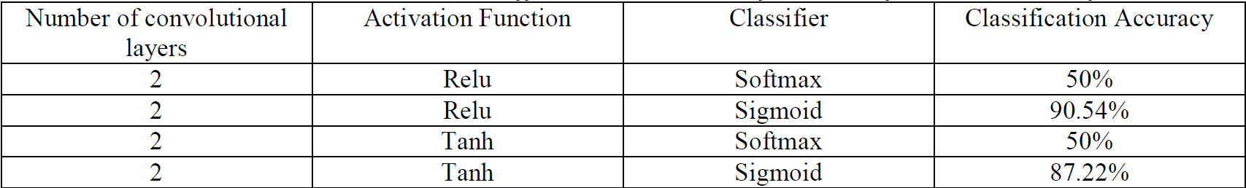
Obtained accuracies with different combinations of activation function and classifier

Slide 23
Literature Review
-ZHANG ZITENG
Topic 2: Facial detection using deep learning
Open CV (Open source computer vision)
a library started by Intel in 1999
Process image
be implemented on the latest algorithms
Classifier
haarcascade_eye and haarcascade_frontalface_default
Train requires images (positive and negative)
Deep Belief Network (DBN)
a graphical model or type of deep learning architecture

Slide 24
DBN architecture

Slide 25
Results
Currently, this model is able to recognize faces correctly but when tried for videos, it takes more time for processing.
The advantage:
recognize blurred images and side face images.
In the future, this can recognize persons by using video capture.

Slide 26
Video image recognition on obstacle detection in an intelligent vehicle
Literature Review
-Leong Soong Jun
Method: Multi-model background detection, illumination, shadow removal
Multi-sensor technology: Detect and identify the target in colour target
Further investigation: Obstacle detection technology
Algorithms to refer: shadow removal, obstacle detection

Slide 27

Deep-learning based automatic recognition network
Literature Review
-Leong Soong Jun
China implemented in agricultural production
Both have the similarity of concepts which recognized the images
Methods: Image classification, colour adjustment, motion blur elimination, filter dataset

Slide 28
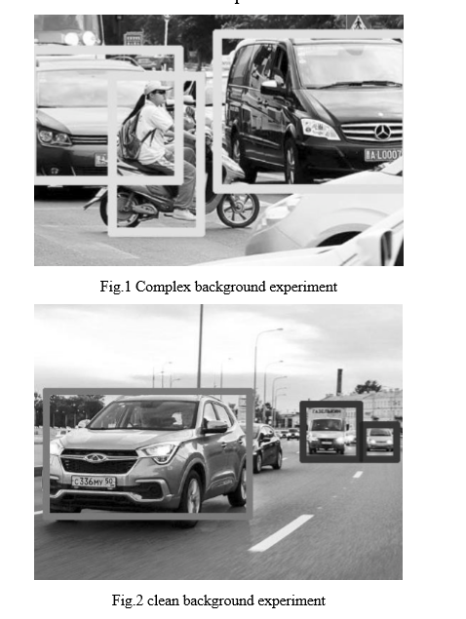
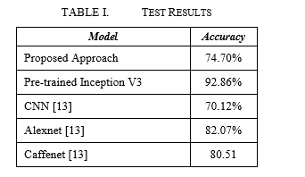
Literature Review
-Tan Wei Xian
The Usage Of Transfer Learning in Neural Network

Slide 29
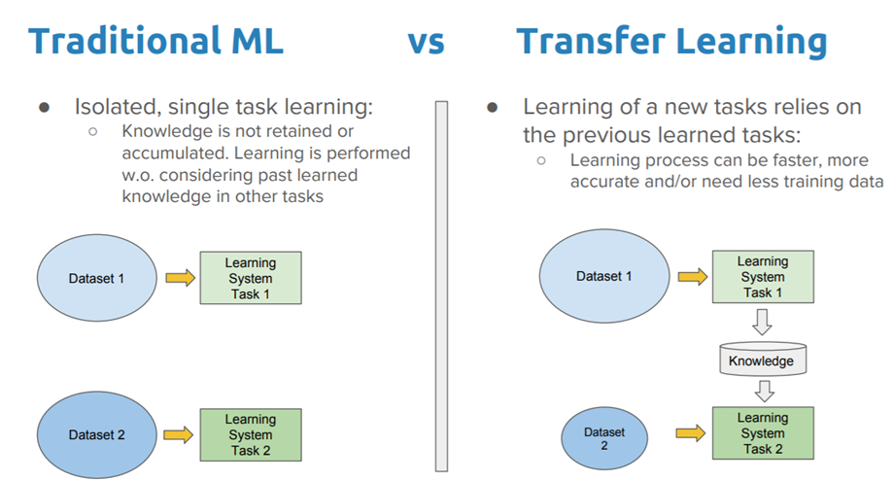
The relevance of the literature review to the implementation
Literature Review
-Tan Wei Xian

Slide 30

Deep Learning Approach for Image Classification
Literature Review
-Lyu Chen Yang
The research on artificial neural networks began in the 1940s.
The Hopfield network was proposed in the early 1980s. This activates the artificial neural network
In 2006, the concept of deep learning was first proposed , artificial neural networks are again of great interest to the research community.

Slide 31
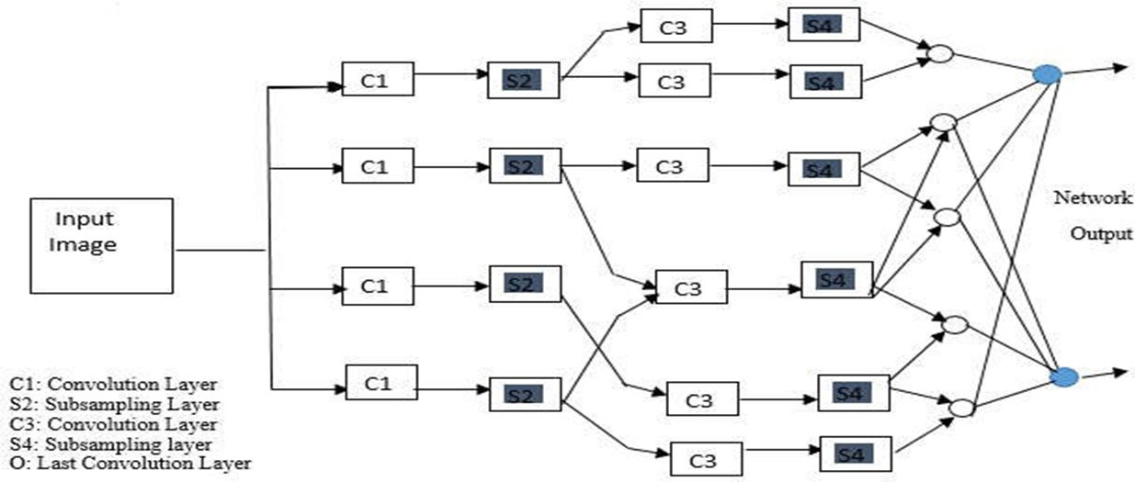
A CNN comprises of three primary kinds of layers:
(i)convolution layers,
(ii) subsampling layers
(iii) an output layer.

Slide 32
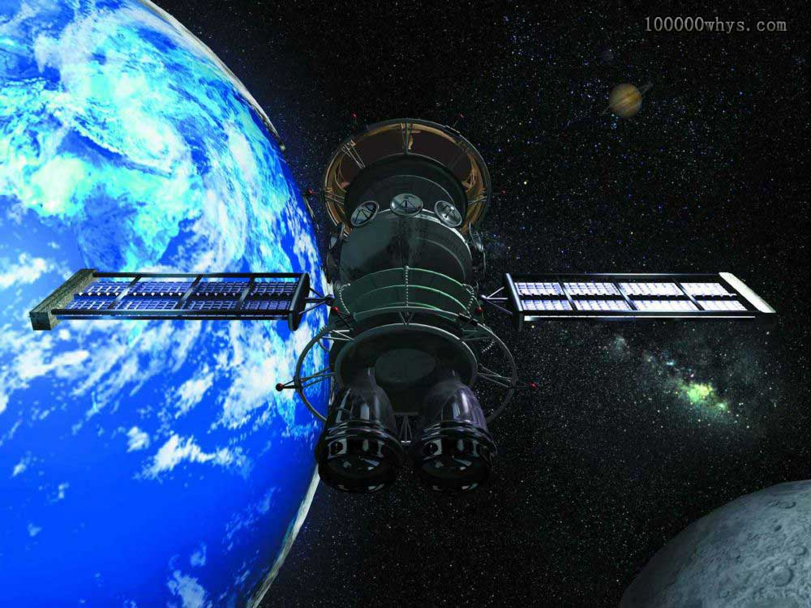
Satellite Image Classification with Deep Learning
Literature Review
-Lyu Chen Yang
Satellite imagery is important for many applications
Deep learning is a class of machine learning models that represent data
CNN's powerful computing power is provided by advanced gpus

Slide 33
Thank you!
ZHANG ZITENG TP052096
TAN WEIXIAN TP048417
LEONG SOONG JUN TP050994
LYU CHEN YANG TP052020

